Slide 1
Next Up:
Miriam C. Wiesner

Slide 2
3
3

Slide 3
2

Slide 4
1

Slide 5
Practical PowerShell Empowerment for Protectors (Blue Team)
Miriam C. Wiesner

Slide 6

Many thanks to our sponsors:

Slide 7



Miriam C. Wiesner
Sr. Security Research Program Manager @ (recently: Sr. Security Researcher)
Author of the book “PowerShell Automation and Scripting for Cybersecurity - Hacking and defense for red and blue teamers”
Book raffle at the end of the session! :-)

Slide 8









Is PowerShell dangerous and should it be disabled?
Really, just no.
No.
How can PowerShell support your workloads and processes?
Protect your identities
Harden your environment
Set up a robust monitoring system
It is nearly impossible to go unnoticed using PowerShell
cscript/wscript
cmd

Slide 9





Automation and compliance: DSC
Desired State Configuration (DSC)
https://learn.microsoft.com/en-us/powershell/scripting/dsc/overview
Microsoft365 DSC
https://microsoft365dsc.com/

Slide 10
Automation and compliance: Manage Updates
Scan-RemoteUpdates.ps1

Slide 11
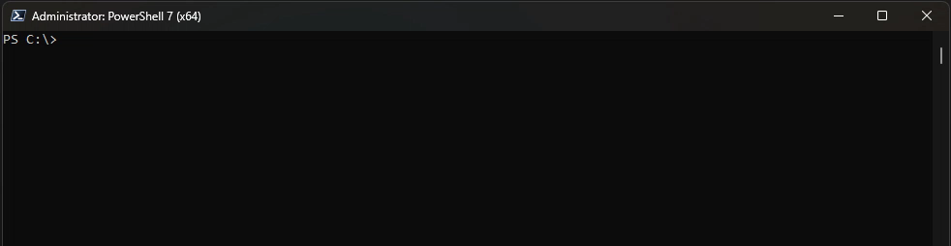
Control who is allowed to do what and where
Full Language mode: Default
No Language mode
Restricted Language mode
Should only be used when working with localization files.
Constrained language mode

Slide 12
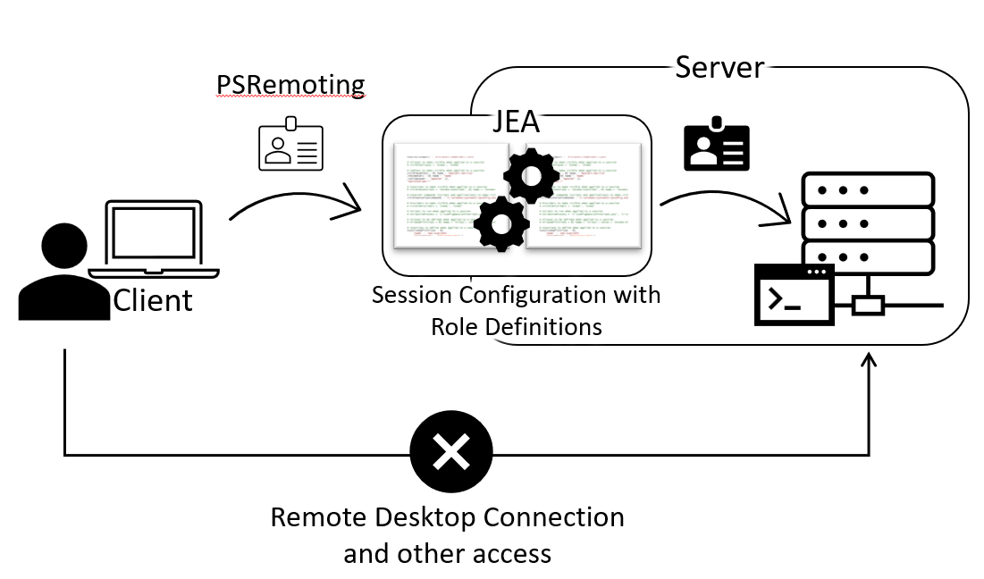
Control who is allowed to do what and where
Just Enough Administration
https://github.com/PSSecTools/JEAnalyzer
Read-JeaScriptFile -Path $scriptPath | Export-JeaRoleCapFile -Path "$rolePath\JEAnalyzer-RunScript-RoleCapability.psrc" -Author "Miriam" -Company "JEAnalyzer"
$scriptBlock = Get-SBLEvent | Where-Object Username -like "JEALAB\vicvega" | Select-Object Code
Read-JeaScriptblock -ScriptCode $scriptBlock | Export-JeaRoleCapFile -Path "$rolePath\JEAnalyzer-Logs-RoleCapability.psrc" -Author "Miriam" -Company "JEAnalyzer"

Slide 13
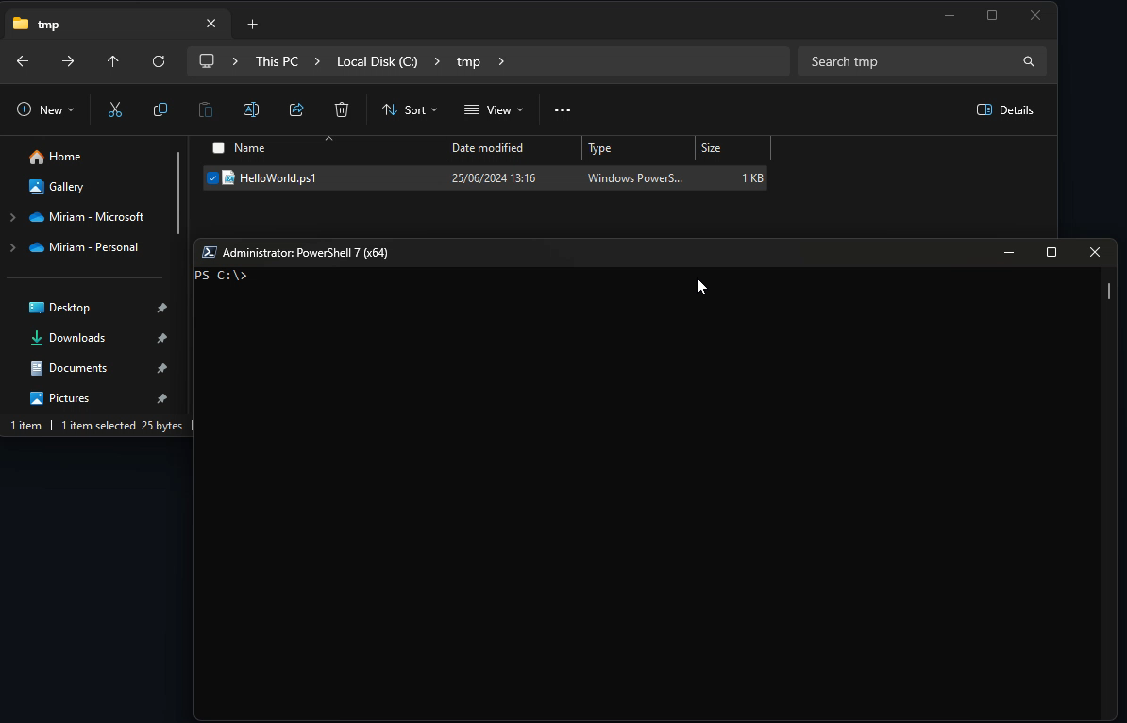
Restrict Scripts – Execution Policy

Slide 14
Restrict Scripts: Application Control & Code Signing
If application control is enforced, PowerShell will run in constrained language mode only
No execution of risky language elements like Add-Type, COM objects and some .NET types to execute arbitrary APIs
If signed files are explicitly trusted, they run in FullLanguage mode

Slide 15
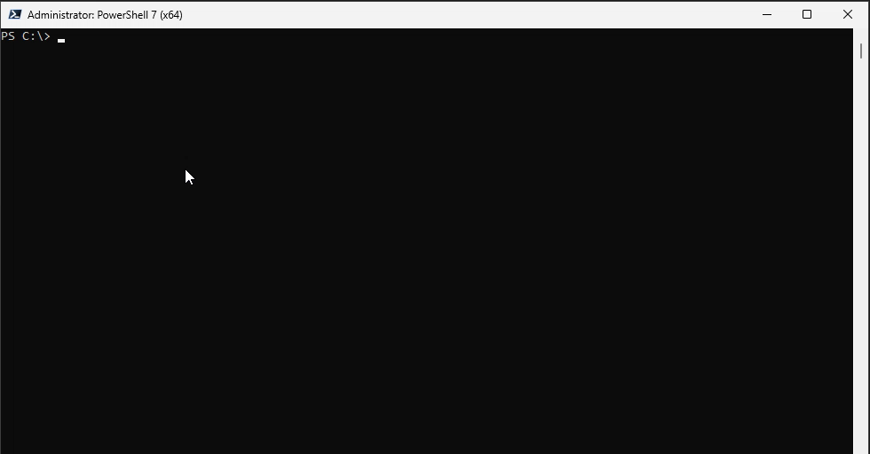
Restrict Scripts: Application Control & Code Signing

Slide 16
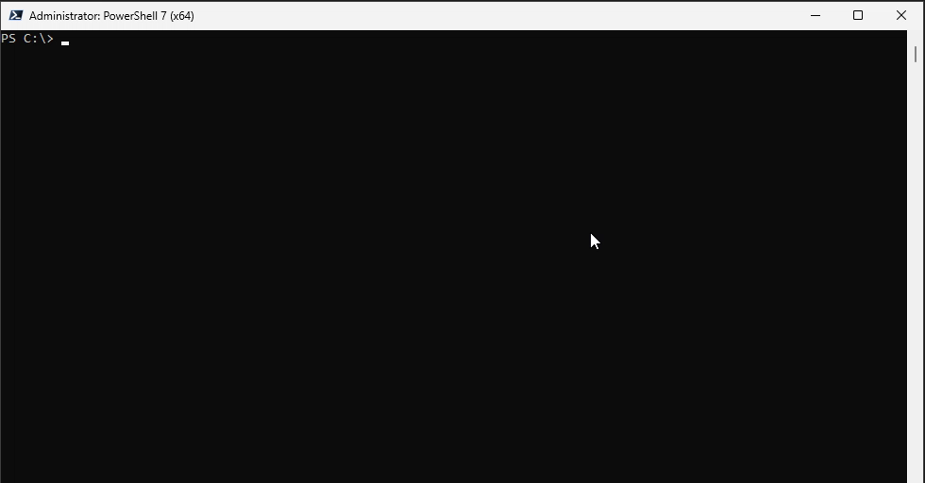
Restrict Scripts: Application Control & Code Signing

Slide 17
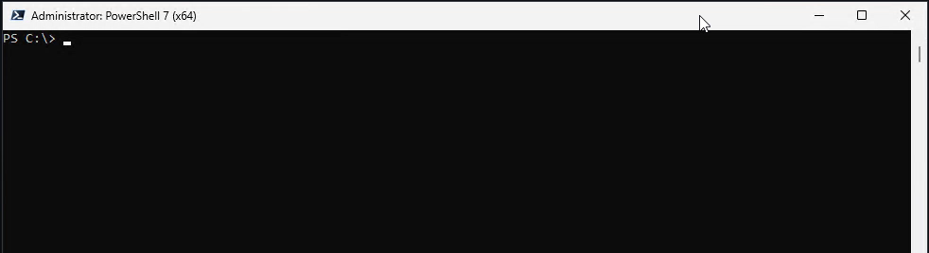
Detect and stop malicious code with AMSI

Slide 18










Detect and stop malicious code with AMSI
PowerShell Methods
Scripts/ interactive use/ dynamic code
Hook: amsi.dll
Win32 APIs
Operating system
Log
Trigger
Antivirus
Response
Behavior log
PowerShell

Slide 19
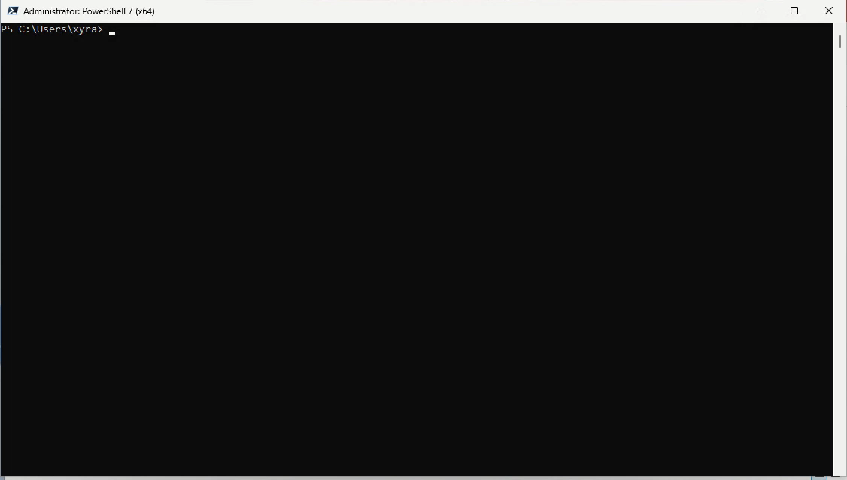
Monitoring and Logging: Transcripts
Default output folder: %userprofile%\Documents of the current user

Slide 20
Monitoring and Logging: Transcripts
Enable Transcripts by default
Computer Configuration | Policies | Administrative Templates | Windows Components | Windows PowerShell | Turn on PowerShell Transcription
Configure your PSRemoting session to use transcripts
New-PSSessionConfigurationFile -Path "$env:userprofile\Documents\PSSession.pssc" -TranscriptDirectory "C:\tmp“
Register-PSSessionConfiguration -Name MyPSSession -Path "$env:userprofile\Documents\PSSession.pssc“
$session = New-PSSession -ComputerName RemoteServer -ConfigurationName MyPSSession
Invoke-Command -Session $session -ScriptBlock { $PSVersionTable }

Slide 21
Monitoring and Logging
Resume Scan-RemoteUpdates.ps1
Get-PSHistory.ps1

Slide 22
Monitoring and Logging: Module Logging
Event ID 4103
Windows PowerShell:
Computer Configuration | Policies | Administrative Templates | Windows Components | Windows PowerShell | Turn on Module Logging
Microsoft-Windows-Powershell/Operational event log
PowerShell Core:
Computer Configuration | Administrative Templates | PowerShell Core | Turn on Module Logging
PowerShell Core/Operational event log
Troubleshoot modules in the current session
Import-Module <Module-Name>
(Get-Module <Module-Name>).LogPipelineExecutionDetails = $true
Get all Module Logging events
$PSWinEventLog = @{ ProviderName = "Microsoft-Windows-PowerShell"; Id = 4103 }
$PSCoreEventLog = @{ ProviderName = "PowerShellCore"; Id = 4103 }
Get-WinEvent -FilterHashtable $PSWinEventLog, $PSCoreEventLog

Slide 23
Monitoring and Logging: ScriptBlock Logging
Event ID 4104
If Script Block Invocation Logging is enabled
Event IDs 4105 and 4106
Windows PowerShell
Computer Configuration | Policies | Administrative Templates | Windows Components | Windows PowerShell
Microsoft-Windows-Powershell/Operational event log
PowerShell Core
Computer Configuration | Administrative Templates | PowerShell Core
PowerShell Core/Operational event log
Get all ScriptBlock Logging events
$PSWinEventLog = @{ ProviderName = "Microsoft-Windows-PowerShell"; Id = 4104 }
$PSCoreEventLog = @{ ProviderName = "PowerShellCore"; Id = 4104 }
Get-WinEvent -FilterHashtable $PSWinEventLog, $PSCoreEventLog

Slide 24
Automation and compliance: Monitoring and Logging
Get-ExecutedCode.ps1

Slide 25
Win the book
https://aka.ms/mw-book-raffle
Get the book (with a discount 🤩)
Packt Pub (EU): https://packt.link/pt3XL
Amazon.com (US & other): https://packt.link/73Or6
The book’s GitHub repository
https://aka.ms/mw-book-github

Slide 26
Q&A
15 minutes
Please do not forget to rate this session in the app :-)

